Slide 1
Assignment 2
Ryan Revels-Scholte

Slide 2
Order of Logical Operator Precedence
! > && > ||
If statements are used to execute a segment of code only if a test condition is evaluated as true.In Unit 2, we would only show the HTML form if the
$errors variable has a value that is greater than 0.
Syntax:
if
($errors > 0){
//show form
}

Slide 3
Cont…
Each statement inside the if code block MUST end with a semicolon as you would expect. The code shown above would only run if the conditional test result is true. If you wanted an alternate block of code to run when the conditional test is false, you would use an else clause. In the form example from Unit 2, the else condition contains code to display the retrieved values instead of the submission form.
Syntax:
if
($errors > 0){
//showform
}else{
//show retrieved values
}

Slide 4
Multiple Comparisons - Boolean Operators
Sometimes comparing two values isn’t enough information to make a decision. For example, a common case is when you encounter division by zero. Let’s say you want to perform a block of code when the ratio of x to y is less than 1. Your test would look like:
if (x/y<1)...
If y is 0 your program will crash because division by zero (#/0) does not produce a result your program can handle. To prevent this from happening, you need to verify that x/y < 0 AND y!=0
You could rewrite the test as follows:
If (x/y<1&&y!=0)

Slide 5
Short Circuit Evaluation
Because of the nature of the AND/OR comparisons, some shortcuts can be used by the interpreter. If you are comparing multiple tests with only ANDs (&&), then you can stop the evaluation as soon as the first ‘false’ test is seen because no matter what follows, the test will never be TRUE.

Slide 6
Nesting IF statements
Sometimes your task may require extra comparison tests to ultimately determine the value of the test. Let’s consider a bank account example in which an “empty” message will display if the balance is 0, a “too low” message will be displayed if the balance is between 0 and 50, and a “low message” will be displayed if the balance is between 50 and 100.
Please note two things with the above structure:
• The indenting – Every time you evaluate a condition and do an action, indent. Your code is so much more readable.
•The comments alone tell you what you need to write. You will NOT get tripped up with the syntax if you have a proper plan

Slide 7
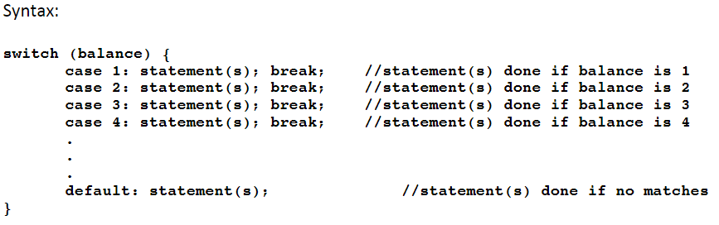
Switch Statements
The switch statement can be used when you have a series of if conditions that is discrete in nature (i.e. comparison against a single integer).

Slide 8
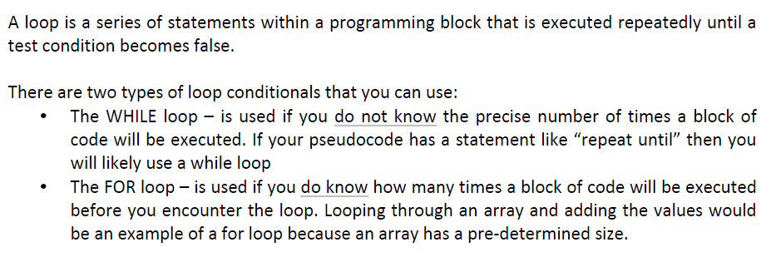
Loops

Slide 9
While Loops
The while loop has the following syntax:
while(test){
//code to execute
}
At the start of each loop cycle, the test is evaluated to determine if it is true. If it is, the code in the block will be executed and the test will be evaluated again as the next loop cycle starts.

Slide 10
Cont…
The statements within the block will execute repeatedly until something happens to make the test false. If the test never becomes false, your have an infinite loop and your program will never proceed past that point. When the event occurs that makes the test false, the current loop cycle will continue until the loop sequence is finished. When the test is evaluated at the start of the next cycle, the code that follows the loop will resume.
If you need to leave the loop immediately, you can use a break;
statement to immediately leave the block of code.

Slide 11
For Statements
The for loop has the following syntax:
for(counter = initial_value; test; counter_step)
{
//code to execute
}
At the start of the loop, the counter is set to an initial value. This is only done when the loop is encountered for the first time.

Slide 12
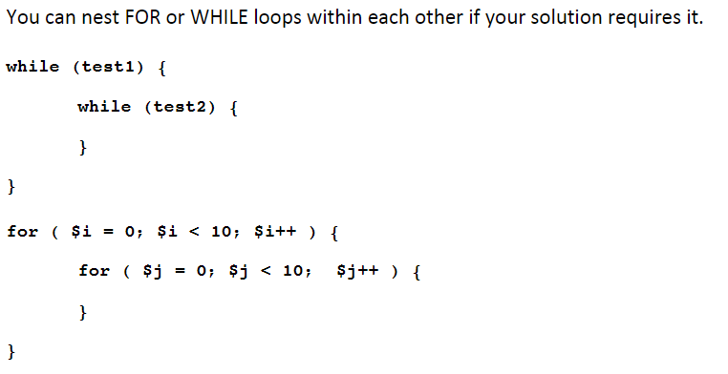
For/While

